Slide 1
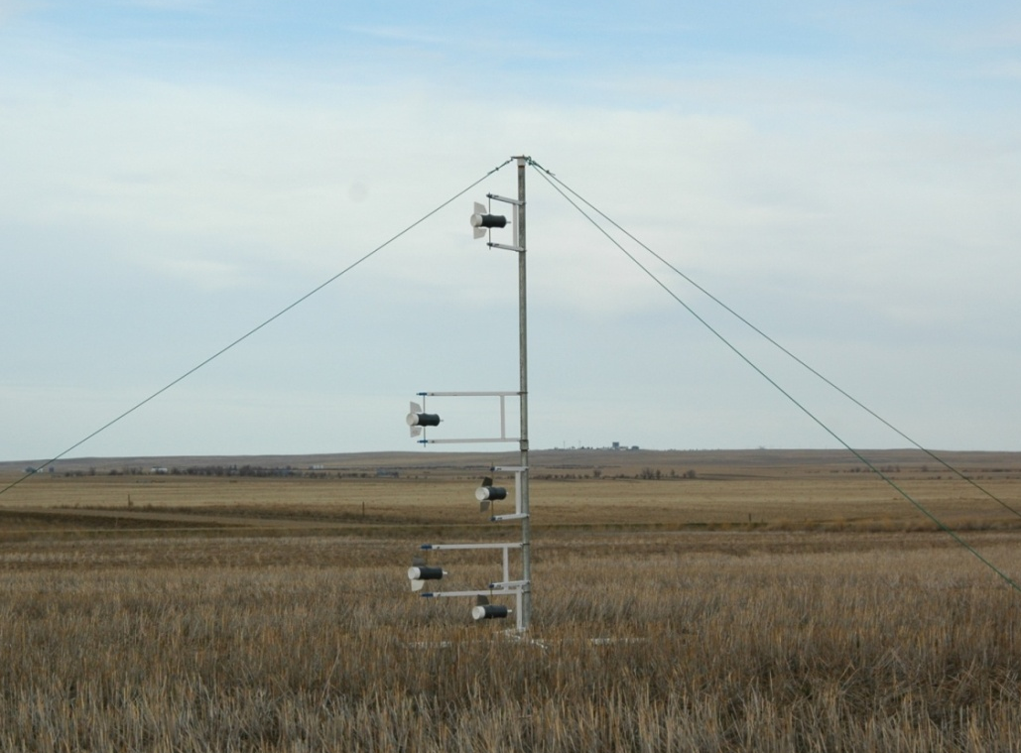
Quantification of NH₃ volatilization from urea applied to cold soils in Montana
Richard Engel, Ph.D.
Dept. of Land Resources and Environmental Sci.
Montana State University

Slide 2
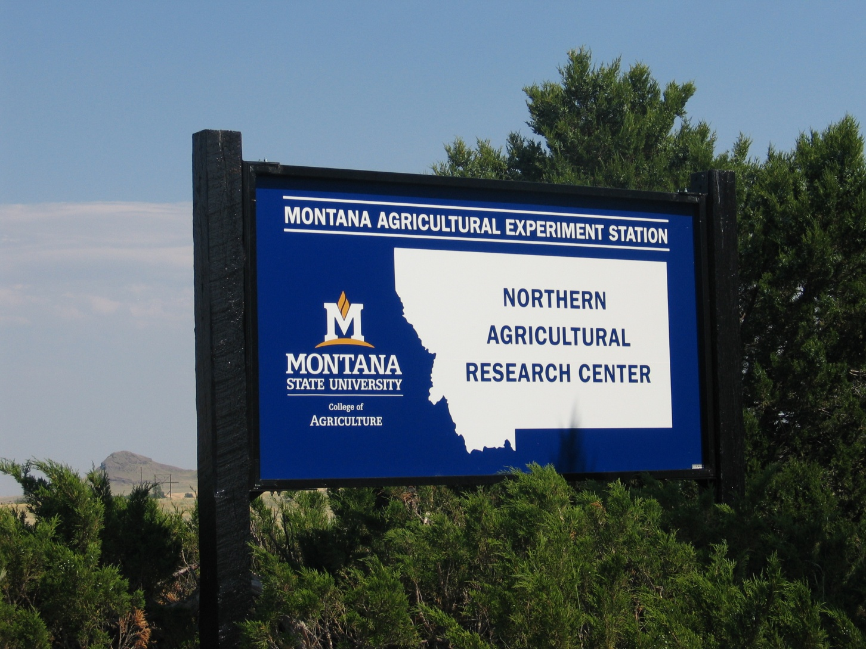
Cooperator: Jeff Whitmus, Research Assistant

Slide 3
Urea reactions in the soil
urease
urea + H₂O (NH₄)₂CO₃
(NH₄)₂CO₃ rapidly dissociates to form NH₄⁺ and CO₃⁻²
CO₃⁻² + H₂O HCO⁻₃ + OH⁻
OH⁻
NH₄⁺
OH⁻
NH₄⁺
NH₄⁺
NH₄⁺
OH⁻
OH⁻
OH⁻
NH₄⁺
OH⁻
NH₄⁺
urea prill
pH 2.5 to 3.5 units

Slide 4
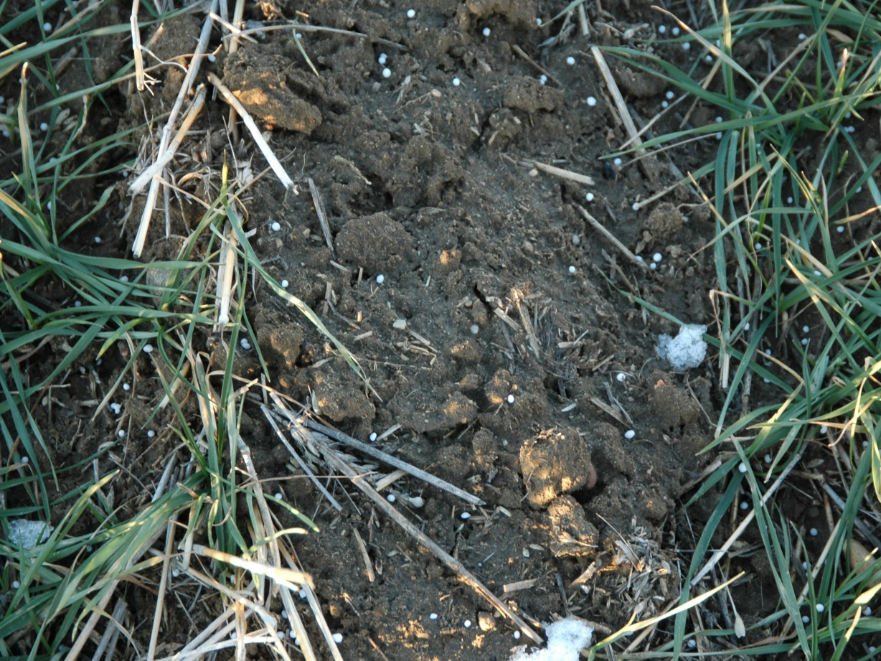
Urea reactions
hydrolysis can lead to large increases in pH around fertilizer prill
NH₄⁺ + OH⁻ NH_{3(g)} + H₂O

Slide 5
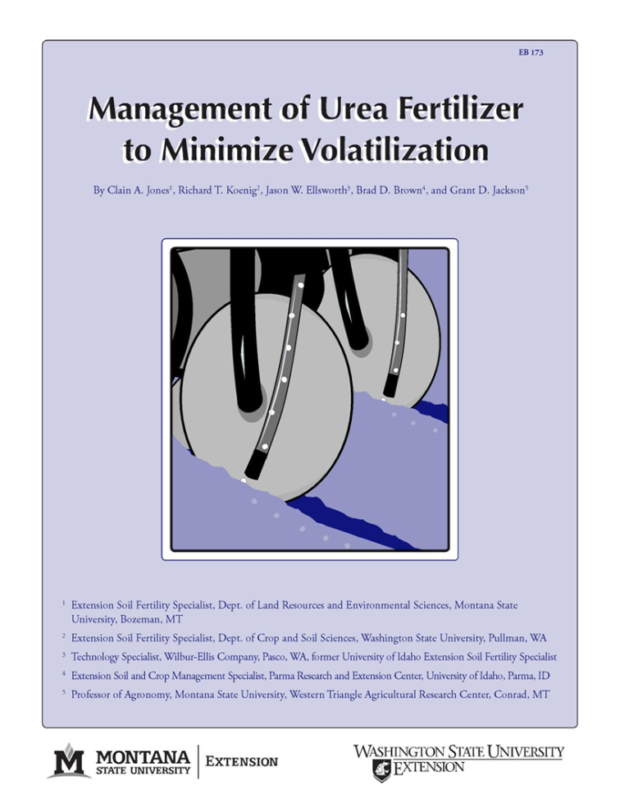
Urea & volatilization – previous work
lot of work published
factors influencing losses are well-known: e.g. soil moisture, CEC, temperature, pH
Big question ….. How much are we losing ?

Slide 6
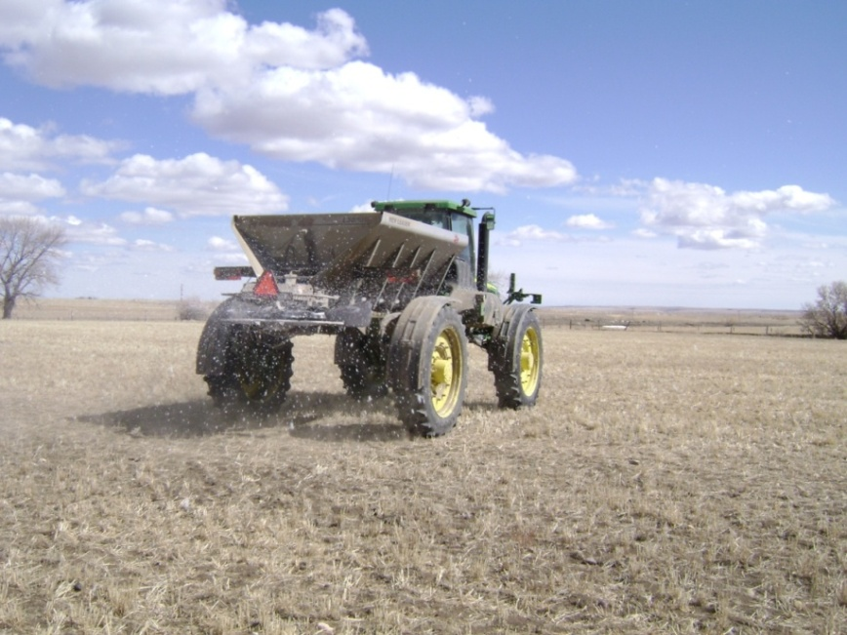
Background - Montana fertilizer urea use
Surface broadcast applications are common practice particularly in dryland winter wheat systems
late-fall, winter, early spring - cold soils
The potential for ammonia loss has long been acknowledged from this practice, but is this a problem in our State?

Slide 7
Project objectives
Quantify ammonia volatilization losses for spring, fall (early,late) and winter applications of urea ?
How do we mitigate losses?
  e.g. enhanced urea products, NBPT coated urea (Agrotain)
  e.g. timing & incorporation with air-seeders

Slide 8
NBPT = n-(n-butyl) thiophosphoric triamide
urease inhibitor
allows more time for urea to diffuse away from point of application so soil pH is moderated
.… or rainfall events so urea is leached below the soil surface
OH⁻
OH⁻
OH⁻
OH⁻
OH⁻
OH⁻
OH⁻
OH⁻
OH⁻
urea
OH⁻
urea +NBPT

Slide 9
Any questions ?

Slide 10
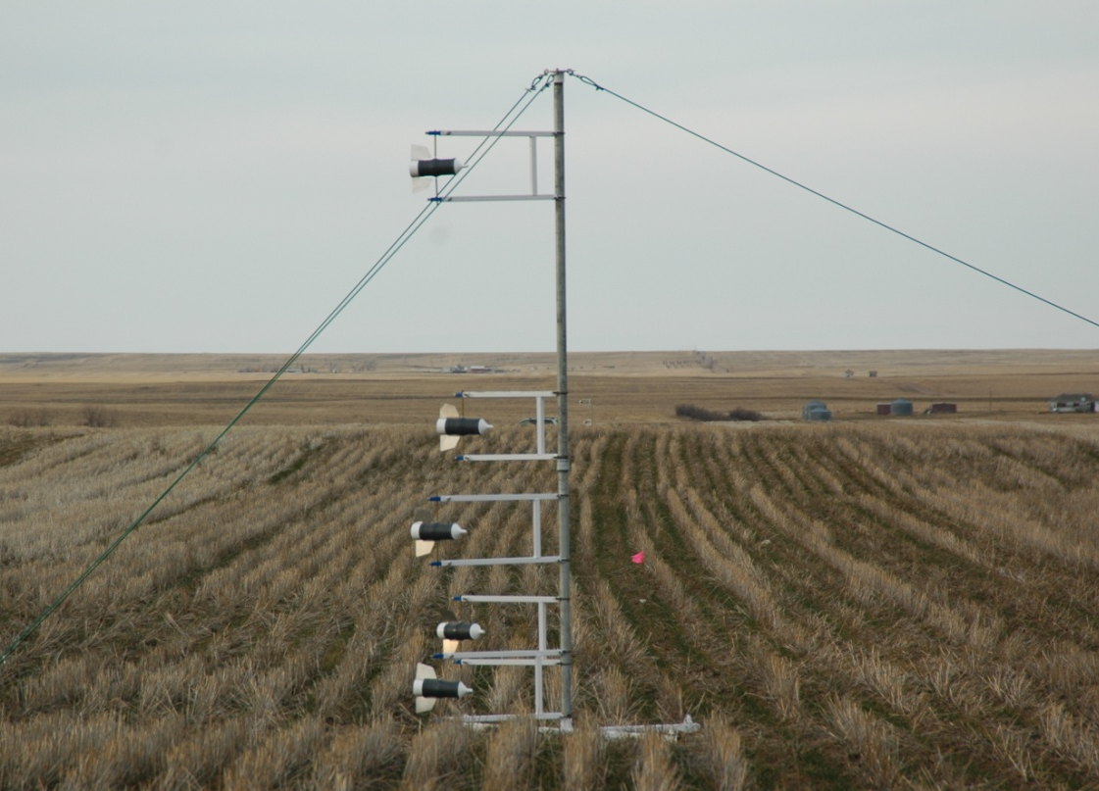
Method – integrated horizontal flux
micrometeorological - preferred approach for quantifying gas losses
does not disturb the soil-atmosphere environment
moderate size plots (~0.3 acre)
continuous measurement of NH3_{(g)}loss over time
mast and shuttles

Slide 11
Method – circular plots (20 m)
urea-N rate - 90 lbs/acre
Agrotain rate (4 quart/ton)
large unfertilized buffer areas around plots required !
urea + Agrotain
background
200 m
20 m
+ urea

Slide 12
Methods – masts & shuttles (traps for NH_{3(g)})
height of
gas profile development
wind direction
diffusion &
turbulence
5 shuttles - gradient spacing
convection
NH_{3(g)}
NH_{3(g)}
NH_{3(g)}
urea granules
masts placed in the center of circular plot

Slide 13
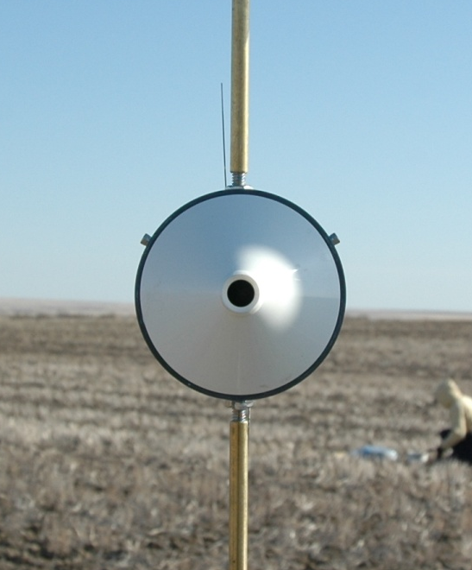
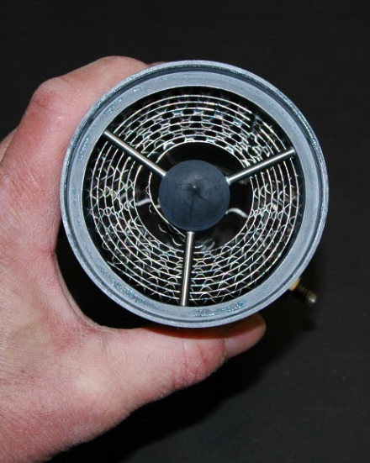
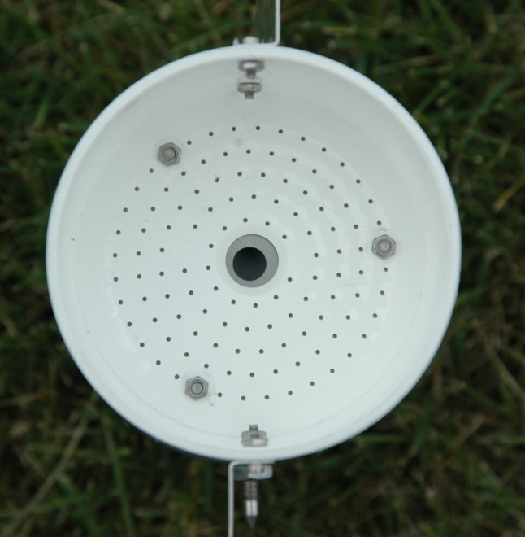
Method - shuttles
traps for collecting ammonia, idea & design developed in Australia (Leuning et al., 1985. Atmos. Environ)
stainless steel spiral
coated with oxalic acid
back
front

Slide 14
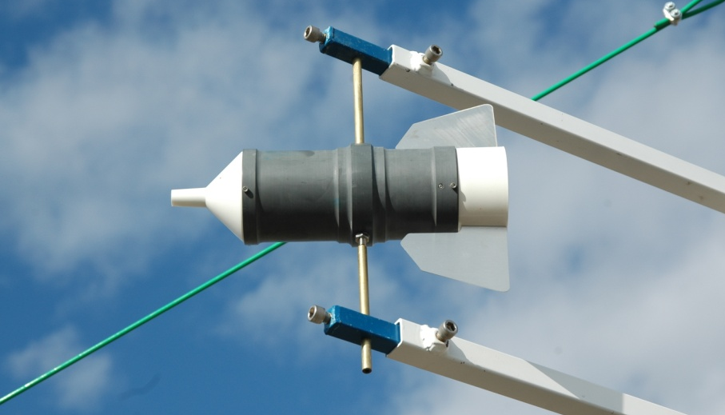
Methods - shuttles
traps for collecting ammonia, idea & design developed in Australia (Leuning et al., 1985. Atmos. Environ)
NH_{3(g)}
rotate on pivot & face into wind
Notes:
Read slide.

Slide 15
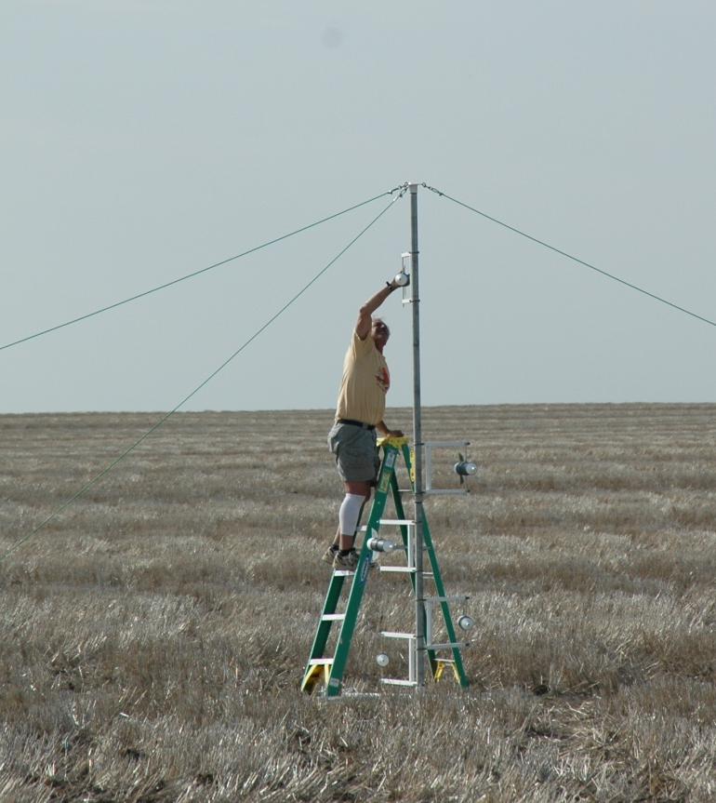
Method-continuous measurement
Spent shuttles exchanged with recharged shuttles every week
recharged shuttles

Slide 16


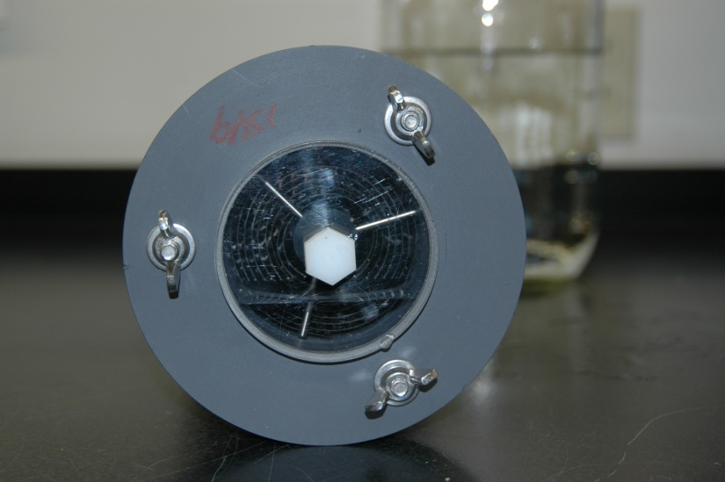
How are NH_{3(g)} losses quantified?
Key points
  NH_{3(g)} trapped in shuttles eluted in lab & quantified
  horizontal flux calc. - effective shuttle sampling area is known via wind tunnel tests (Leuning et al., 1985)
  height vs. horizontal flux diagrams (treated area)
  background NH₃ (mast placed in untreated area)
  known fetch distance (20 m.)
x
x
net area ÷ fetch distance
x
x
Height
x
x
x
x
x
x
Horizontal flux
measured in five planes

Slide 17
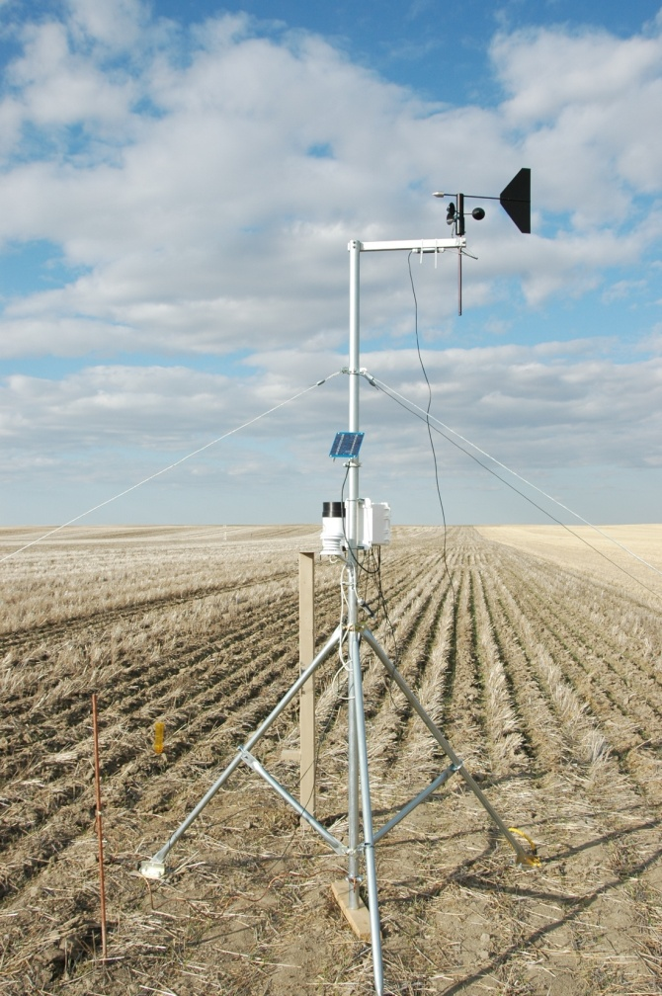
Any questions ?

Slide 18
Kaercher farm site - background
10 miles west of Havre, Hill County
Phillips-Elloam silt loam
pH 6.0
3 gas sampling campaigns – 8 wks
no till winter wheat

Slide 19
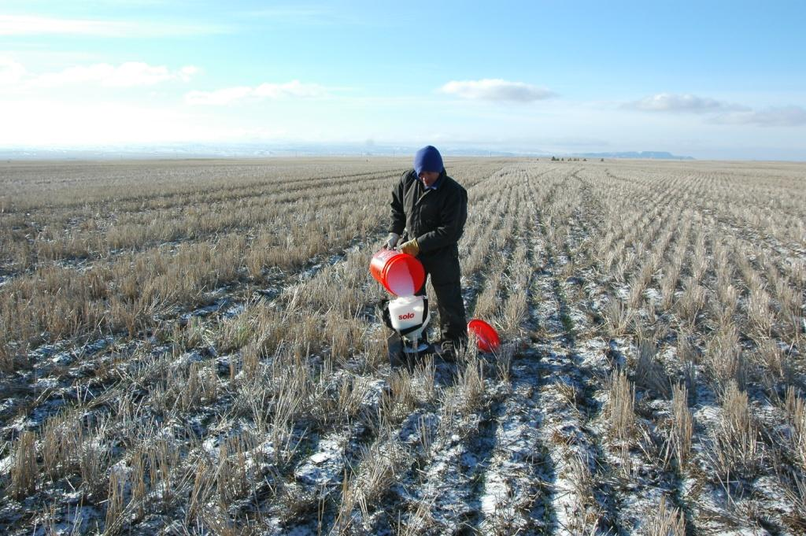
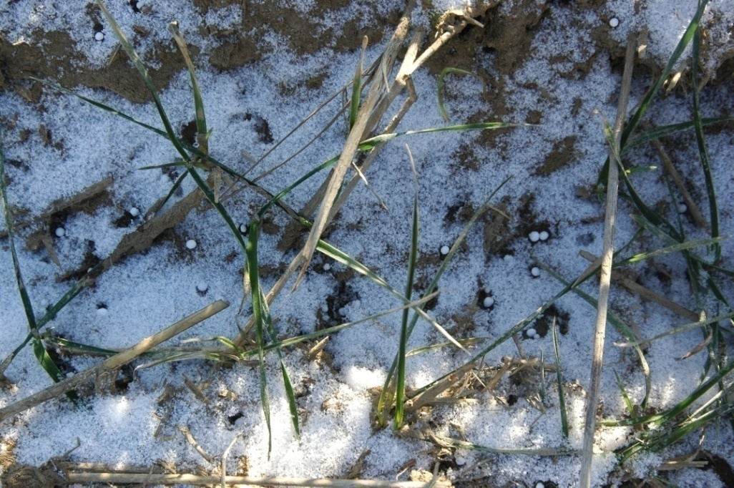
Kaercher site - Spring 2009 – Campaign #5
Fertilized applied – March 26
“light snow on soil surface &
air-temp. 21 F”
soil surface with fertilizer prills beginning to dissolve

Slide 20
Kaercher site – Ammonia losses - #5
Precipitation
no rain 0-2 wks
1.54” 2-8 wks
Soil temp (1 cm) = 34.3 F
Air temp. = 33.1 F
Soil temp (1 cm) = 38.5 F
Air temp. = 38.7 F

Slide 21
Peterson farm site - background
28 miles NW of Havre, Hill County
Telstad-Joplin loam
pH 5.5
2 gas sampling campaigns – 8 wk
no till winter wheat

Slide 22
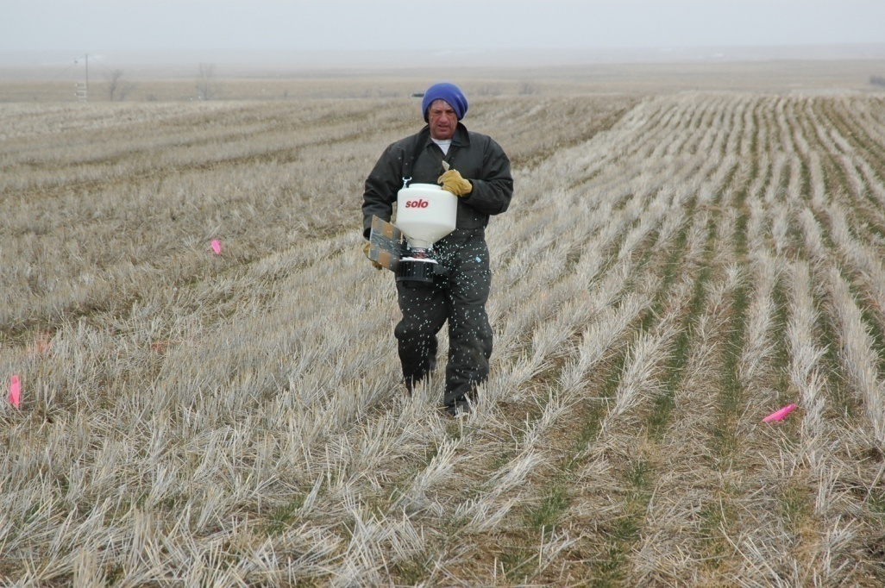
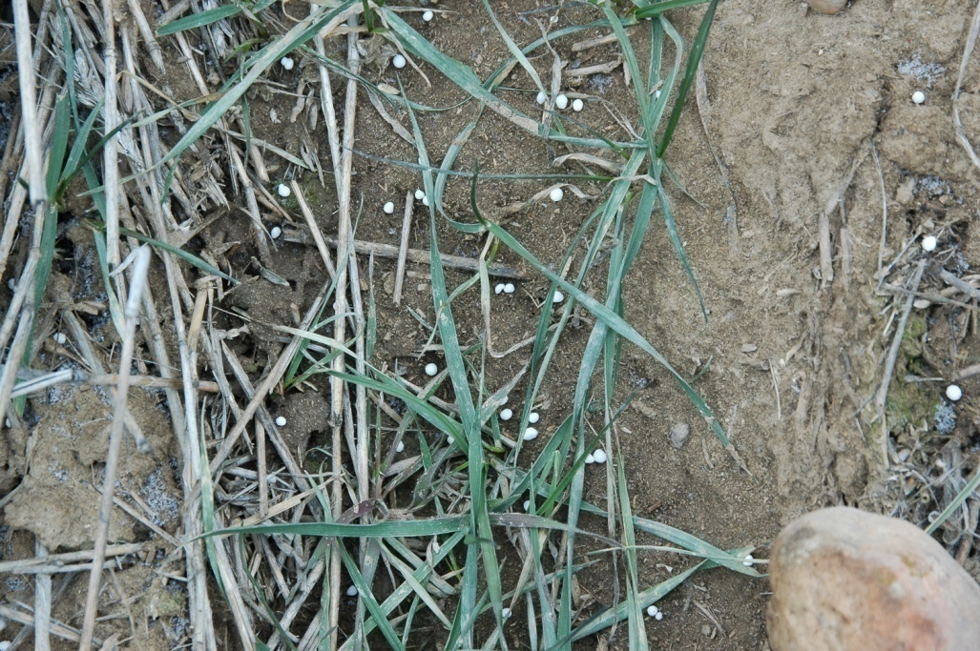
Peterson site - Spring 2009 - Campaign #4
Fertilized applied – March 25
“light snow & air-temp. 18 F”
soil surface frozen
30 F

Slide 23
Peterson site - Spring 2009 – Campaign #4
Precipitation .
0.01” = 0-2 wks
0.89” = 2-8 wks
Soil temp (1 cm) = 38.0 F
Air temp. = 41.5 F
Soil temp (1 cm) = 30.7 F
Air temp. = 33.4 F

Slide 24
Peterson site - Spring 2009 – Campaign #4
Soil urea analysis
hydrolysis occurs more slowly in cold soils
3 wks before urea is gone

Slide 25
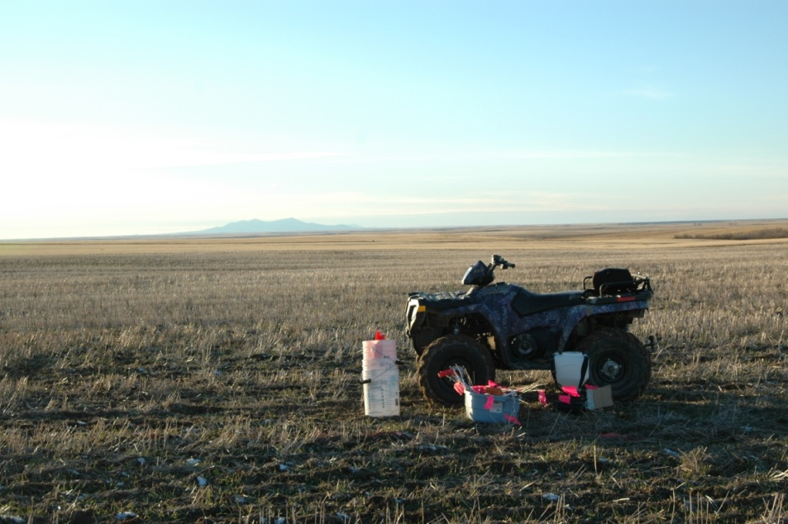
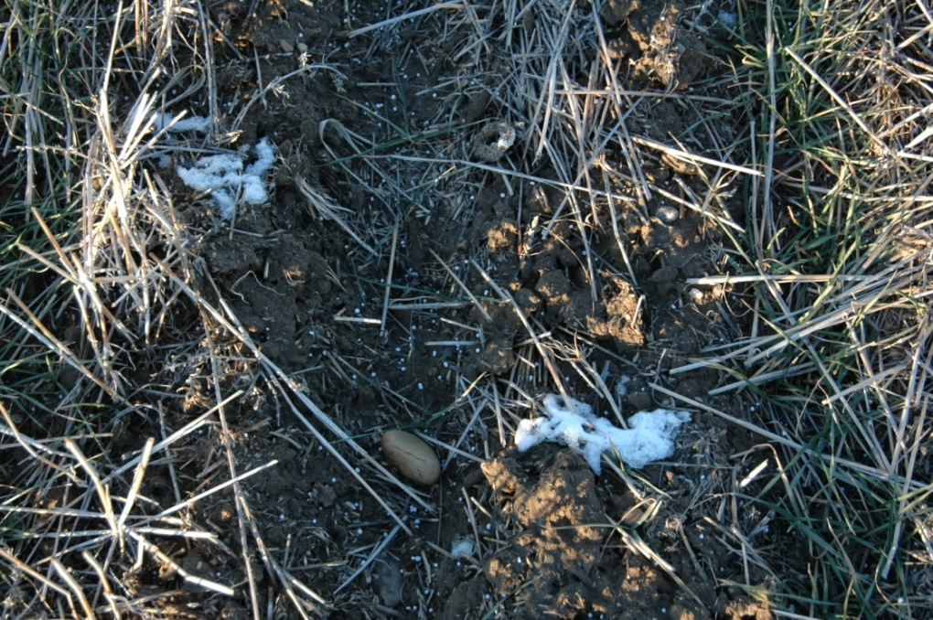
Peterson site - Fall 2008 - Campaign #3
November 14 - fertilization date
surface damp from melting snow

Slide 26
Peterson site - Fall 2008 - Campaign #3
Soil-temp. (1 cm)
  0-1 wk = 33.8 F
  1-3 wk = 28.9 F

Slide 27
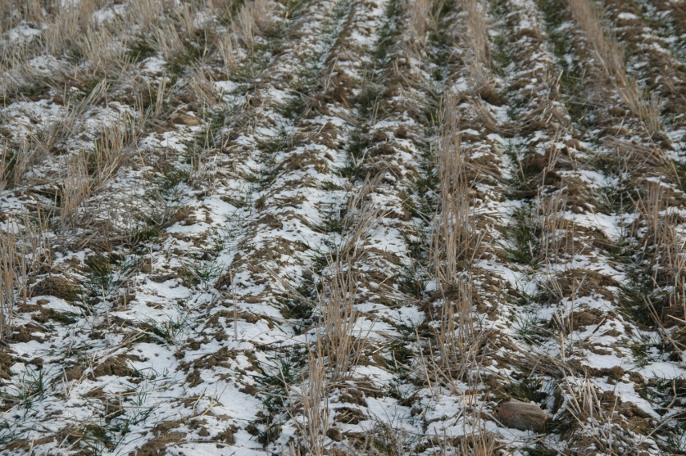
Peterson site - Fall 2008 - Campaign #3
Precipitation – trace amounts over first 3 wks
Dec 4th - 3 wks post-fertilization

Slide 28
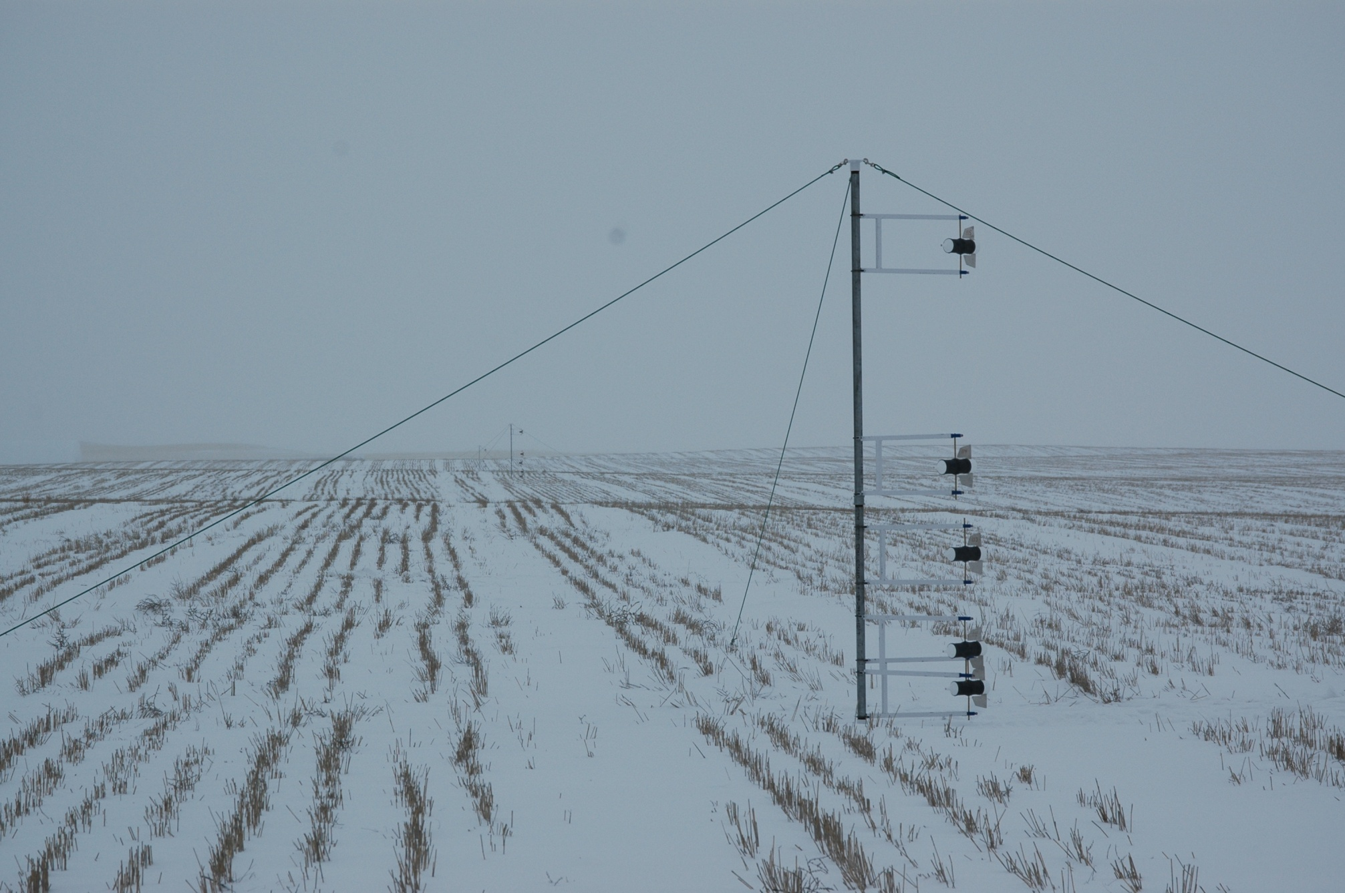
December 18th … winter arrived!

Slide 29
Urea-N volatilization loss summary†
Campaign | Cooperator site | Fertilization date |  | Urea | Agrotain
 |  |  |  | -------------- % -------------
1 | Kaercher | 2008 | April 3 | 8.4 | 4.4
2 | Kaercher | 2008 | Oct. 9 | 3.1 | 1.4
3 | Peterson | 2008 | Nov. 14 | 31.5 | 4.0
4 | Peterson | 2009 | March 25 | 35.6 | 18.0
5 | Kaercher | 2009 | March 26 | 39.9 | 18.1
23.7
9.2
†
percentage of applied N lost as NH_{3(g)}

Slide 30
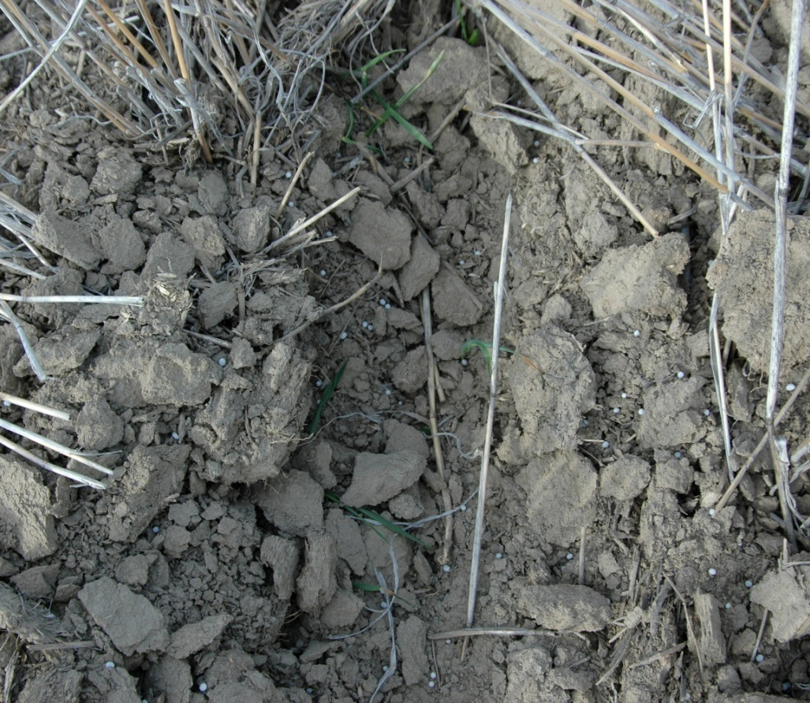
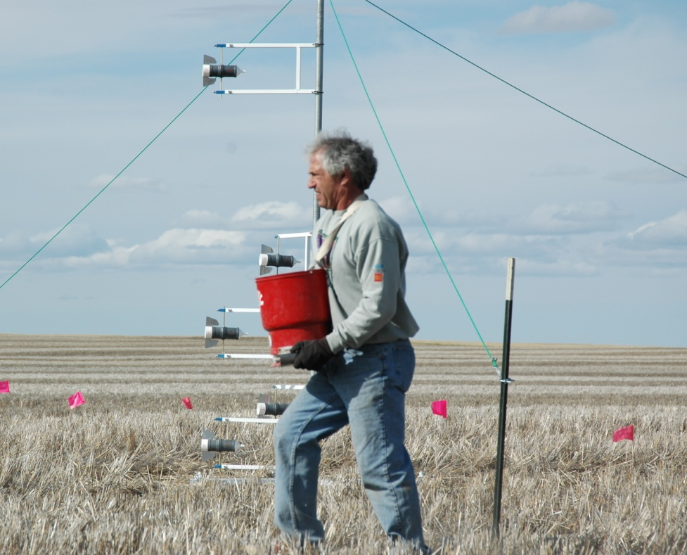
Kaercher site (Campaign #2) - low emission
October 9, 2008 application, air-temp. 45 F
dry soil & no rain for 24 day
Nov. 2-5 = 0.98” ppt.
1 wk post-fertilization

Slide 31
Agrotain economics
assuming urea costs $ 380/ton
Agrotain adds ~$55/ton urea (4 quart rate) - $435
$ 55
x 100 = 14.5%
$ 380
N losses or differential between urea and Agrotain would need to be ~14.5%

Slide 32
Urea-N volatilization loss summary†
Campaign | Cooperator site | Fertilization date |  | Urea | Agrotain
 |  |  |  | -------------- % -------------
1 | Kaercher | 2008 | April 3 | 8.4 | 4.4
2 | Kaercher | 2008 | Oct. 9 | 3.1 | 1.4
3 | Peterson | 2008 | Nov. 14 | 31.5 | 4.0
4 | Peterson | 2009 | March 25 | 35.6 | 18.0
5 | Kaercher | 2009 | March 26 | 39.9 | 18.1
23.7
9.2
†
percentage of applied N lost as NH_{3(g)}

Slide 33
Summary
significant NH_{3(g)} losses (up to 40% of applied N) from surface applied urea can occur even though soil temperatures are cold!
soil moisture conditions at surface that result in dissolution of urea granules (i.e. prolonged damp) without rain promote high NH_{3(g)} losses.
more common to find these conditions in semi-arid Northern Great Plains during the late fall or early spring.
Agrotain control = 60% reduction in NH_{3(g)}

Slide 34
Future plans
third site this fall (clay loam)
additional gas sampling campaigns (fall, winter, early spring)
complementary study - N source comparisons (urea, sodium nitrate) – paired plots & control
Where does the volatilized ammonia go?
urea
NaNO₃
control
fall
winter
spring
http://landresources.montana.edu/ureavolatilization/

Slide 35
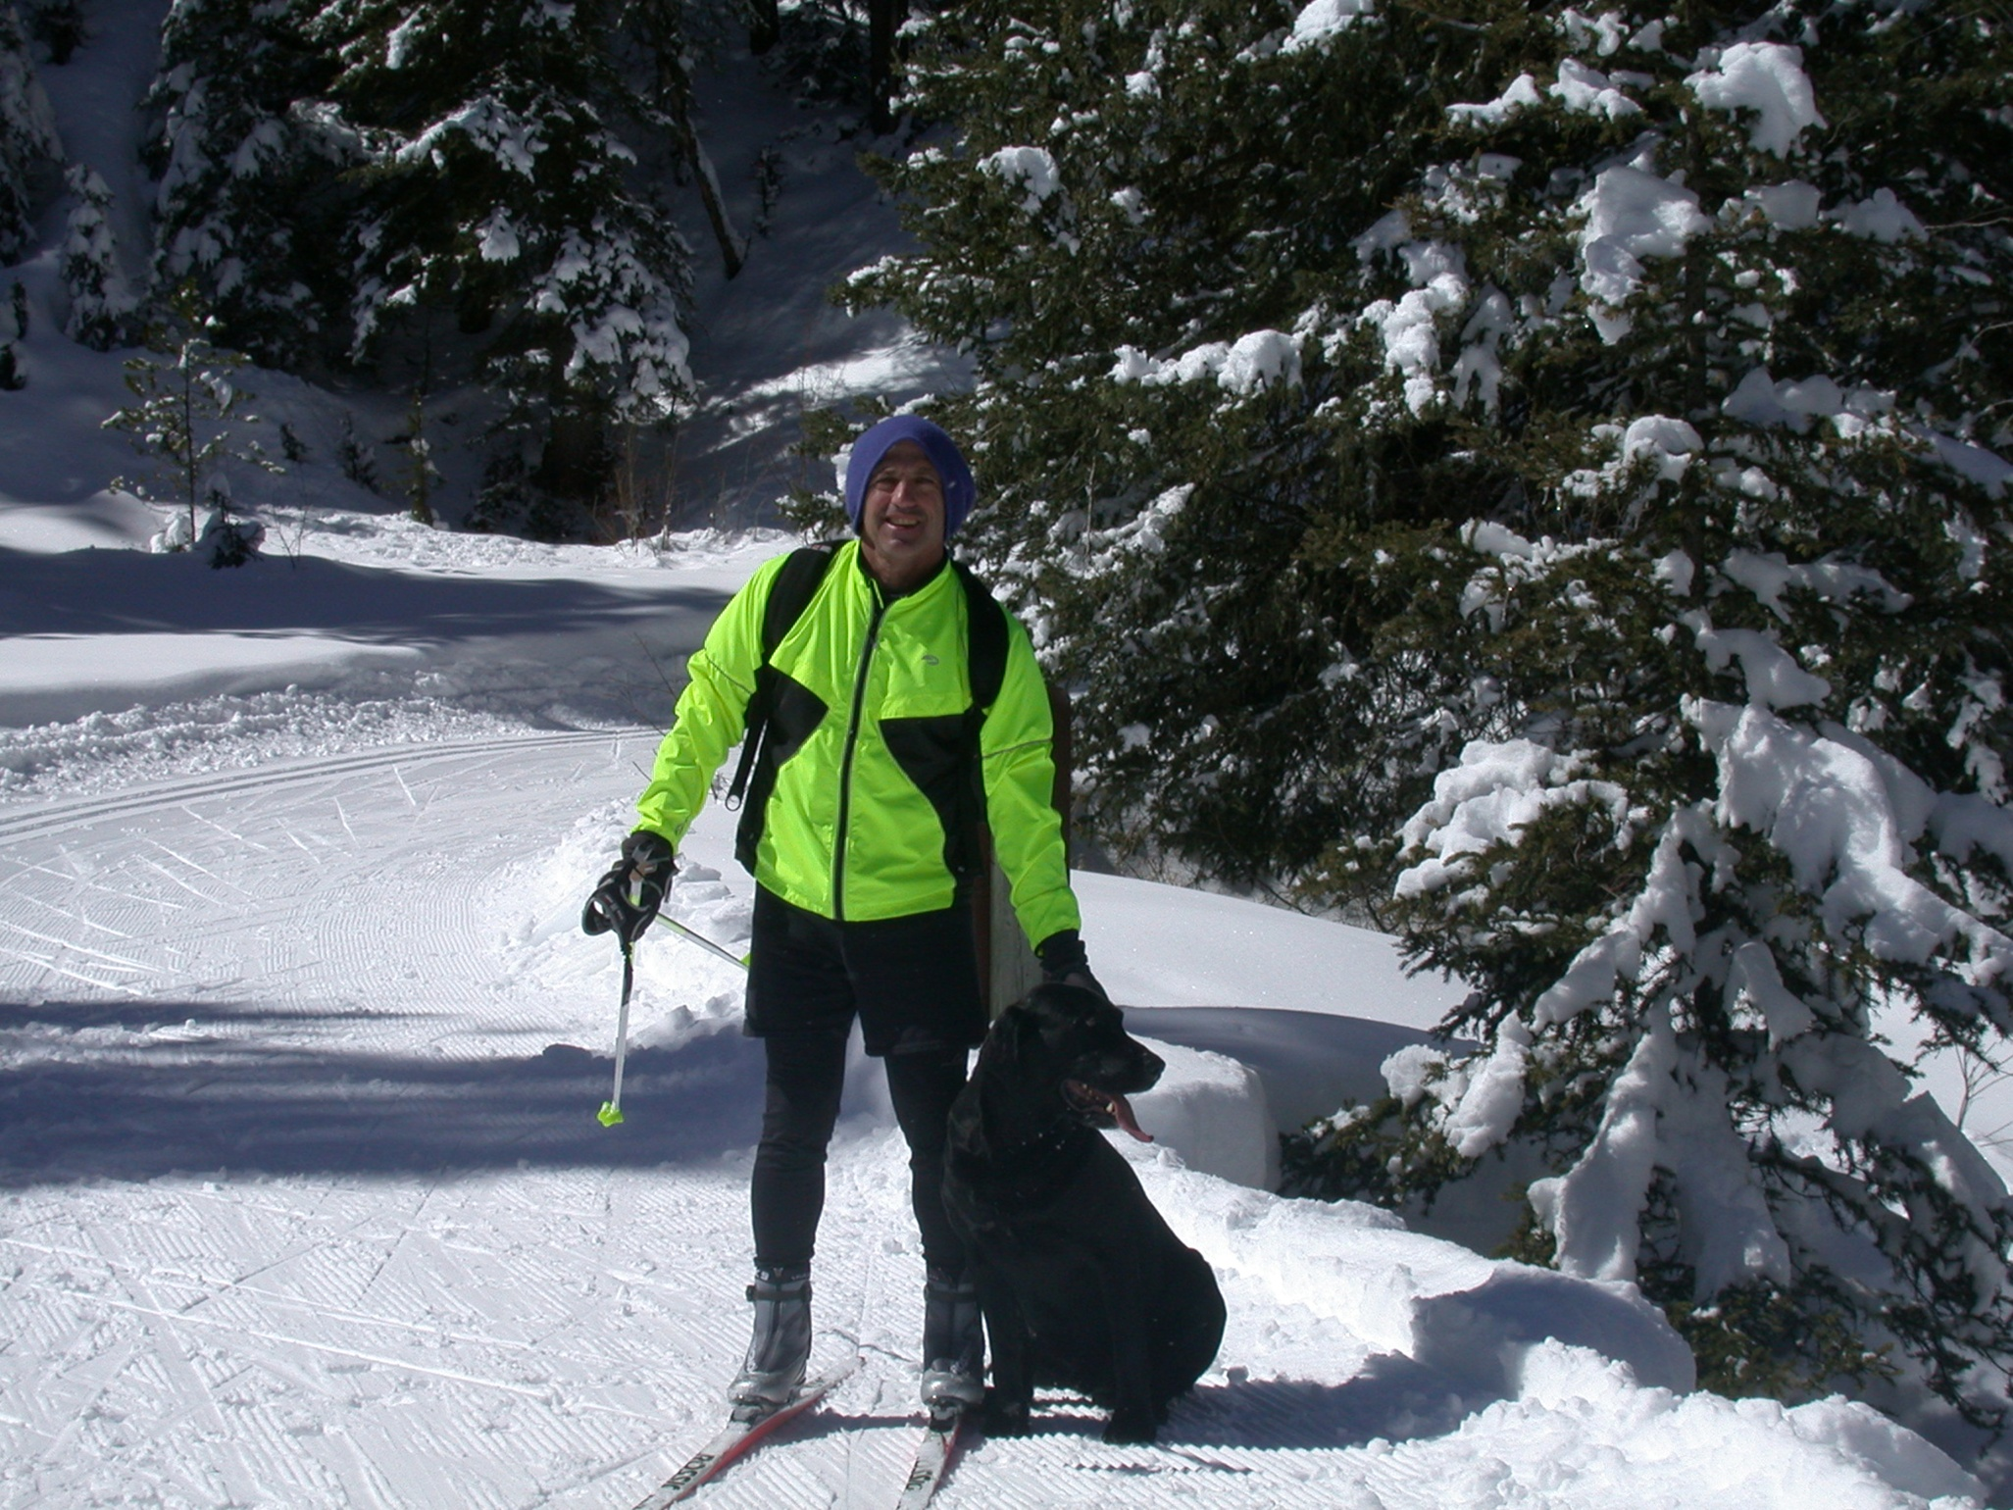
Thank you

